Slide 1

AWARDING OF CONSOLATION BARANGAYS AND MUNICIPALITIES
BARANGAY CATEGORY
MUNICIPALITY CATEGORY

Slide 2
PERFORMING BARANGAY
BARANGAY LUNGA-OG MUNICIPALITY OF STO. TOMAS

Slide 3
PERFORMING BARANGAY
BARANGAY SALVACION MUNICIPALITY OF STO. TOMAS

Slide 4
PERFORMING BARANGAY
BARANGAY STA. FE MUNICIPALITY OF NEW CORELLA

Slide 5
PERFORMING BARANGAY
BARANGAY PATROCENIO MUNICIPALITY OF NEW CORELLA

Slide 6
PERFORMING BARANGAY
BARANGAY STA. CRUZ MUNICIPALITY OF NEW CORELLA

Slide 7
PERFORMING BARANGAY
BARANGAY ESPERANZA MUNICIPALITY OF STO. TOMAS

Slide 8
PERFORMING BARANGAY
BARANGAY KIOTOY
CITY OF PANABO

Slide 9
PERFORMING MUNICIPALITY
MUNICIPALITY OF SAWATA
51.07% of the Health Summit 2026 Indicators
High Donation Rate of 1.17% with a total of 321 Blood Donations
Harmonized Health Awardee 2025

Slide 10
PERFORMING MUNICIPALITY
MUNICIPALITY OF ASUNCION
58.42% of the Health Summit 2026 Indicators
Highest Donation Rate of 1.92% with a total of 1,212 Blood Donations

Slide 11
PERFORMING MUNICIPALITY
MUNICIPALITY OF TALAINGOD
59.24% of the Health Summit 2026 Indicators
Donation Rate of 0.67% with a total of 193 Blood Donations
Harmonized Health Awardee 2025

Slide 12
PERFORMING MUNICIPALITY
MUNICIPALITY OF CARMEN
64.07% of the Health Summit 2026 Indicators
TOP PERFORMING MUNICIPALITY IN THE OPERATIONS OF BARANGAY HEALTH WORKER (BHW) PROGRAM
TOP PERFORMING MUNICIPALITY IN FAMILY PLANNING PROGRAM
High Donation Rate of 1.30% with a total of 1,110 Blood Donations
Harmonized Health Awardee 2025

Slide 13
PERFORMING MUNICIPALITY
MUNICIPALITY OF KAPALONG
68.78% of the Health Summit 2026 Indicators
TOP PERFORMING MUNICIPALITY IN NUTRITION PROGRAM
TOP PERFORMING MUNICIPALITY IN TB PREVENTION AND CONTROL PROGRAM
SPECIAL AWARD IN EPIDEMIOLOGY AND SURVEILLANCE SYSTEM PROGRAM
3rd Highest Donation Rate of 1.55% with a total of 1,251 Blood Donation
Harmonized Health Awardee 2025

Slide 14
AWARDING OF TOP PERFORMING BARANGAYS, CITIES AND MUNICIPALITIES
TOP 3 PERFORMING BARANGAY
TOP 3 PERFORMING CITIES
TOP 3 PERFORMING MUNICIPALITIES

Slide 15
3RD TOP PERFORMING BARANGAY
BARANGAY SAN MIGUEL MUNICIPALITY OF STO. TOMAS

Slide 16
2ND TOP PERFORMING BARANGAY
BARANGAY SAN JOSE MUNICIPALITY OF NEW CORELLA

Slide 17
TOP PERFORMING BARANGAY
BARANGAY MONTE DUJALI
MUNICIPALITY OF SAWATA

Slide 18
3RD TOP PERFORMING CITY
ISLAND GARDEN CITY OF SAMAL
74.22% of the Health Summit 2026 Indicators

Slide 19
3RD TOP PERFORMING CITY
ISLAND GARDEN CITY OF SAMAL
TOP PERFORMING CITY IN MALE REPRODUCTIVE HEALTH CARE PROGRAM
TOP PERFORMING CITY IN NUTRITION PROGRAM
TOP PERFORMING CITY IN TOBACCO PREVENTION AND CONTROL PROGRAM
TOP PERFORMING CITY IN MENTAL HEALTH PROGRAM
TOP PERFORMING CITY IN HEALTH EDUCATION AND PROMOTION PROGRAM
SPECIAL AWARD IN ENVIRONMENTAL, OCCUPATIONAL HEALTH AND SANITATION PROGRAM
3rd Highest Donation Rate of 1.36% with a total of 1,632 Blood Donations
Harmonized Health Awardee 2025

Slide 20
2ND TOP PERFORMING CITY
CITY OF PANABO
88.03% of the Health Summit 2026 Indicators

Slide 21
2ND TOP PERFORMING CITY
CITY OF PANABO
TOP PERFORMING CITY IN DAVAO DEL NORTE HEALTH INFORMATION AND MANAGEMENT SYSTEM (DHIMS)
TOP PERFORMING CITY IN FAMILY PLANNING PROGRAM
TOP PERFORMING CITY IN RABIES PREVENTION AND CONTROL PROGRAM
TOP PERFORMING CITY IN NON COMMUNICABLE DISEASE (NCD) PREVENTION AND CONTROL PROGRAM
TOP PERFORMING CITY IN DISASTER RISK REDUCTION AND MANAGEMENT IN HEALTH (DRRM H) PROGRAM
TOP PERFORMING CITY IN ADOLESCENT HEALTH AND YOUTH DEVELOPMENT (AHYDP) PROGRAM
TOP PERFORMING CITY IN POPULATION MANAGEMENT SERVICES PROGRAM
SPECIAL AWARD IN WOMEN'S HEALTH CARE PROGRAM
2nd Highest Donation Rate of 1.92% with a total of 4,060 Blood Donations
Harmonized Health Awardee 2025

Slide 22
TOP PERFORMING CITY
CITY OF TAGUM
90.93% of the Health Summit 2026 Indicators

Slide 23
TOP PERFORMING CITY
CITY OF TAGUM
TOP PERFORMING CITY IN LOCAL HEALTH BOARD AND INTER LOCAL HEALTH ZONE PROGRAM
TOP PERFORMING CITY IN THE OPERATIONS OF BARANGAY HEALTH WORKER (BHW) PROGRAM
TOP PERFORMING CITY IN THE DAVAO DEL NORTE ELECTRONIC HEALTH REFERRAL SYSTEM (DEHEARS) PROGRAM
TOP PERFORMING CITY IN THE EXCLUSIVE BREASTFEEDING PROGRAM
TOP PERFORMING CITY IN THE INTEGRATED MANAGEMENT OF CHILDHOOD ILLNESS (IMCI) PROGRAM
TOP PERFORMING CITY IN STI/HIV PREVENTION AND CONTROL PROGRAM
TOP PERFORMING CITY IN EPIDEMIOLOGY AND SURVEILLANCE SYSTEM PROGRAM
SPECIAL AWARD IN NATIONAL IMMUNIZATION PROGRAM
SPECIAL AWARD IN DENTAL HEALTH CARE PROGRAM
SPECIAL AWARD IN TB PREVENTION AND CONTROL PROGRAM
Highest Donation Rate of 2.96% with a total of 8,877 Blood Donations
Harmonized Health Awardee 2025

Slide 24
TOP PERFORMING CITY HEALTH OFFICER
DR. ARNEL R. FLORENDO
City Health Officer of Tagum

Slide 25
3RD TOP PERFORMING MUNICIPALITY
MUNICIPALITY OF STO. TOMAS
76.49% of the Health Summit 2026 Indicators
TOP PERFORMING MUNICIPALITY IN STI/HIV PREVENTION AND CONTROL PROGRAM
TOP PERFORMING MUNICIPALITY IN ADOLESCENT HEALTH AND YOUTH DEVELOPMENT (AHYDP) PROGRAM
TOP PERFORMING MUNICIPALITY IN ENVIRONMENTAL, OCCUPATIONAL HEALTH AND SANITATION PROGRAM
Donation Rate of 0.96% with a total of 1,257 Blood Donations
Harmonized Health Awardee 2025

Slide 26
2ND TOP PERFORMING MUNICIPALITY
MUNICIPALITY OF B.E. DUJALI
80.48% of the Health Summit 2026 Indicators
TOP PERFORMING MUNICIPALITY IN MALE REPRODUCTIVE HEALTH CARE PROGRAM
TOP PERFORMING MUNICIPALITY IN POPULATION MANAGEMENT SERVICES PROGRAM
High Donation Rate of 1.04% with a total of 373 Blood Donations
Harmonized Health Awardee 2025

Slide 27
TOP PERFORMING MUNICIPALITY
MUNICIPALITY OF NEW CORELLA
82.40% of the Health Summit 2026 Indicators

Slide 28
TOP PERFORMING MUNICIPALITY
MUNICIPALITY OF NEW CORELLA
TOP PERFORMING MUNICIPALITY IN LOCAL HEALTH BOARD AND INTER LOCAL HEALTH ZONE PROGRAM
TOP PERFORMING MUNICIPALITY IN DAVAO DEL NORTE HEALTH INFORMATION AND MANAGEMENT SYSTEM (DHIMS)
TOP PERFORMING MUNICIPALITY IN THE EXCLUSIVE BREASTFEEDING PROGRAM
TOP PERFORMING MUNICIPALITY IN RABIES PREVENTION AND CONTROL PROGRAM
TOP PERFORMING MUNICIPALITY IN TOBACCO PREVENTION AND CONTROL PROGRAM
TOP PERFORMING MUNICIPALITY IN HEALTH EDUCATION AND PROMOTION PROGRAM
TOP PERFORMING MUNICIPALITY IN DISASTER RISK REDUCTION AND MANAGEMENT IN HEALTH (DRRM H) PROGRAM
SPECIAL AWARD IN INTEGRATED MANAGEMENT OF CHILDHOOD ILLNESS (IMCI) PROGRAM
SPECIAL AWARD IN WOMEN'S HEALTH CARE PROGRAM
SPECIAL AWARD IN NATIONAL IMMUNIZATION PROGRAM
2nd Highest Donation Rate of 1.62% with a total of 980 Blood Donations
Harmonized Health Awardee 2025

Slide 29
TOP PERFORMING MUNICIPAL HEALTH OFFICER
DR. NANCY O. CACAYORIN
Municipal Health Officer of Carmen

Slide 30
HEALTH SUMMIT 2026
RESULTS

Slide 31
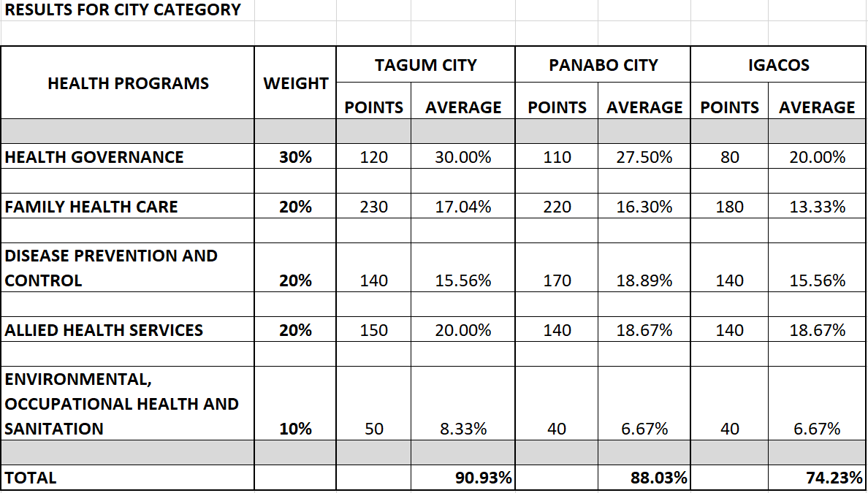

Slide 32
